Slide 1

MATH30
Probability and Statistics

Slide 2
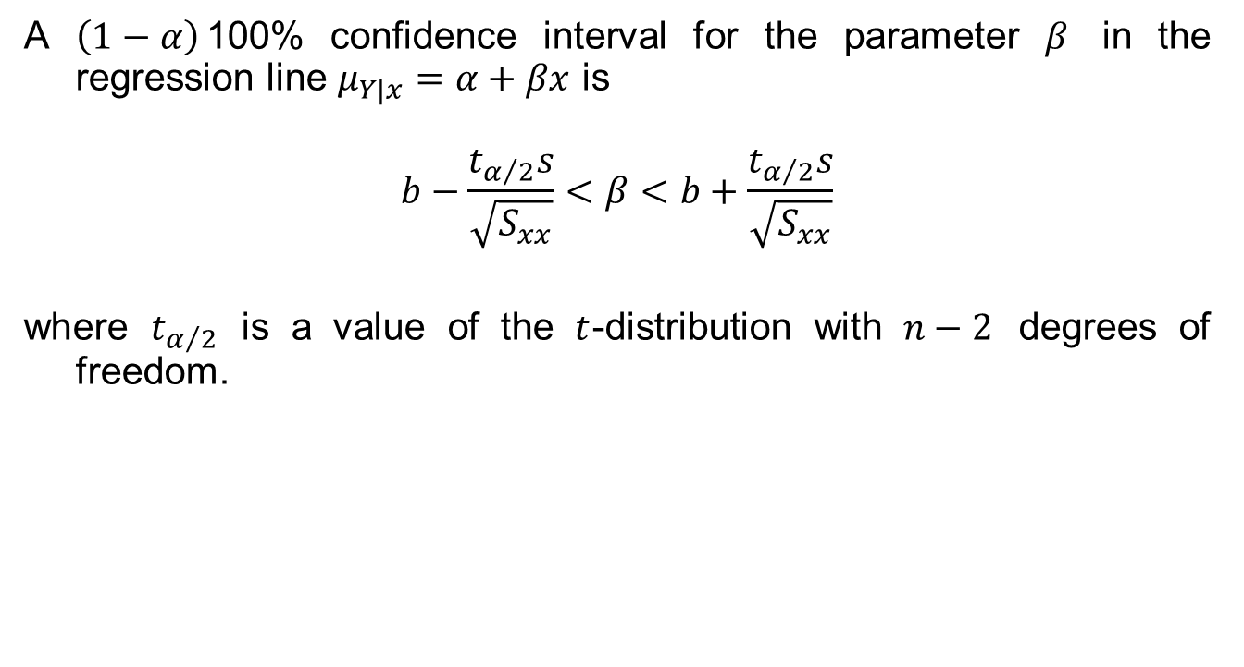

Confidence Interval for $β$
A $\left(1−α\right)$100% confidence interval for the parameter $β$ in the regression line $μ_{Y|x}=α+βx$ is
$$b−\frac{t_{α/2}s}{\sqrt{S_{xx}}}<β<b+\frac{t_{α/2}s}{\sqrt{S_{xx}}}$$
where $t_{α/2}$ is a value of the $t$-distribution with $n−2$ degrees of freedom.

Slide 3

Confidence Interval for $β$
Example 11.2 Find a 95% confidence interval for $β$ in the regression line $μ_{Y|x}=α+βx$, based on the pollution data of Table 11.1.
Solution:

Slide 4

Hypothesis Testing on the Slope
To test the null hypothesis $H_{0}$ that $β=β_{0}$ against a suitable alternative, we again use the $t$-distribution with $n−2$ degrees of freedom to establish a critical region and then base our decision on the value of
$$t=\frac{b−β_{0}}{s/{\sqrt{S_{xx}}}}$$

Slide 5

Hypothesis Testing on the Slope
Example 11.3 Using the estimated value $b=0.903643$ of Example 11.1, test the hypothesis that $β=1.0$ against alternative that $β<1.0$.
Solution:

Slide 6
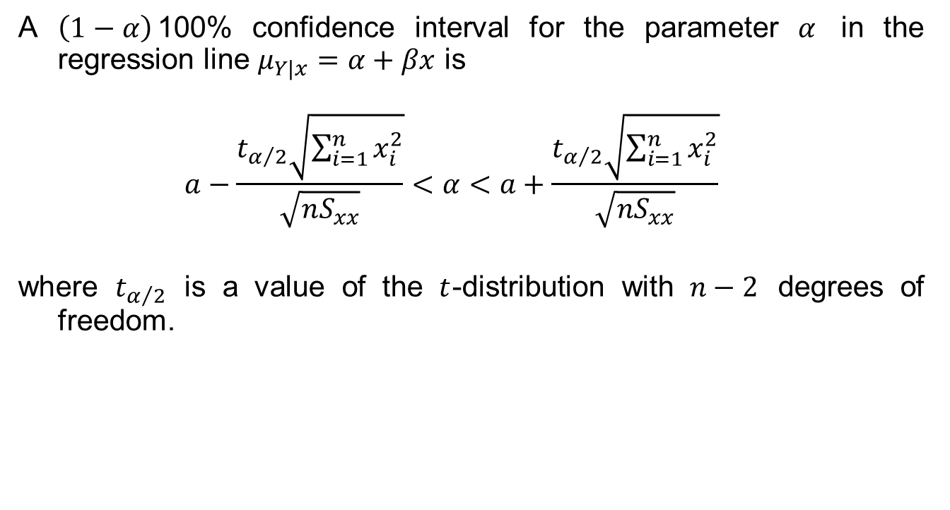

Confidence Interval for $α$
A $\left(1−α\right)$100% confidence interval for the parameter $α$ in the regression line $μ_{Y|x}=α+βx$ is
$$a−\frac{t_{α/2}\sqrt{\sum_{i=1}^{n}{x_{i}^{2}}}}{\sqrt{nS_{xx}}}<α<a+\frac{t_{α/2}\sqrt{\sum_{i=1}^{n}{x_{i}^{2}}}}{\sqrt{nS_{xx}}}$$
where $t_{α/2}$ is a value of the $t$-distribution with $n−2$ degrees of freedom.

Slide 7

Confidence Interval for $α$
Example 11.4 Find a 95% confidence interval for $α$ in the regression line $μ_{Y|x}=α+βx$, based on the data of Table 11.1.
Solution:

Slide 8
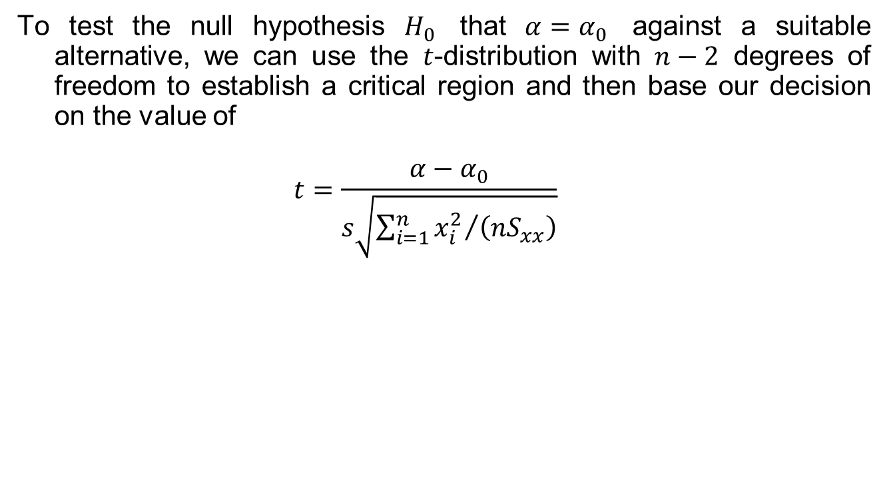
Statistical Inference on the Intercept
To test the null hypothesis $H_{0}$ that $α=α_{0}$ against a suitable alternative, we can use the $t$-distribution with $n−2$ degrees of freedom to establish a critical region and then base our decision on the value of
$$t=\frac{α−α_{0}}{s\sqrt{{\sum_{i=1}^{n}{x_{i}^{2}}}/{\left(nS_{xx}\right)}}}$$

Slide 9

Statistical Inference on the Intercept
Example 11.5 Using the estimated value $a=3.829640$ of Example 11.1, test the hypothesis that $α=0$ at the 0.05 level of significance against the alternative that $α≠0$.
Solution:

